Slide 1
Job Scheduling

Slide 2
Problem Statement
In job sequencing problem, the objective is to find a sequence of jobs, which is completed within their deadlines and gives maximum profit.

Slide 3
Solution
Let us consider, a set of n given jobs which are associated with deadlines and profit is earned, if a job is completed by its deadline. These jobs need to be ordered in such a way that there is maximum profit.
It may happen that all of the given jobs may not be completed within their deadlines.
Assume, deadline of i^{th} job J_{i} is d_{i} and the profit received from this job is p_{i}. Hence, the optimal solution of this algorithm is a feasible solution with maximum profit.

Slide 4
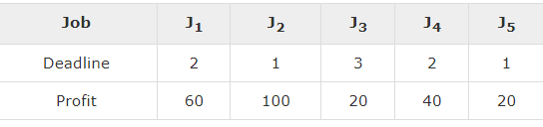
Example
Let us consider a set of given jobs as shown in the following table. We have to find a sequence of jobs, which will be completed within their deadlines and will give maximum profit. Each job is associated with a deadline and profit.

Slide 5
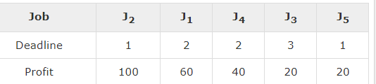
Solution
To solve this problem, the given jobs are sorted according to their profit in a descending order. Hence, after sorting, the jobs are ordered as shown in the following table.

Slide 6
Continue …
From this set of jobs, first we select J₂, as it can be completed within its deadline and contributes maximum profit.
Next, J₁ is selected as it gives more profit compared to J₄.
In the next clock, J₄ cannot be selected as its deadline is over, hence J₃ is selected as it executes within its deadline.
The job J₅ is discarded as it cannot be executed within its deadline.
Thus, the solution is the sequence of jobs (J₂, J₁, J₃), which are being executed within their deadline and gives maximum profit.
Total profit of this sequence is 100 + 60 + 20 = 180.

